Slide 1
Digital Input and output
Fast and effective embedded system chapter3

Slide 2
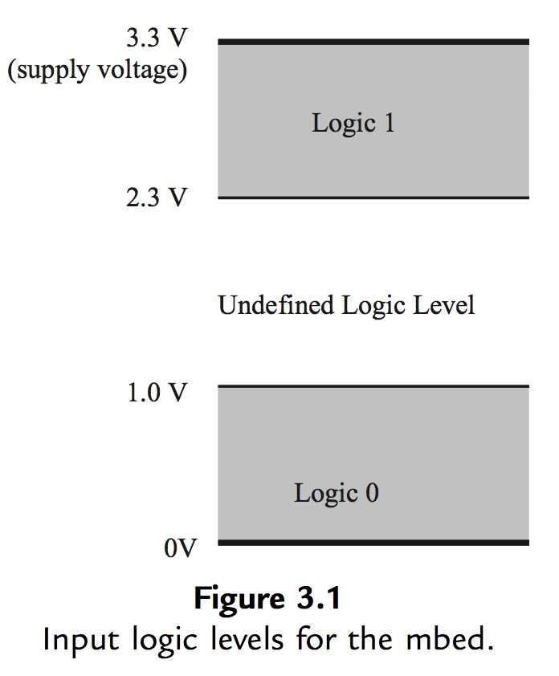
Voltage and logic values

Slide 3
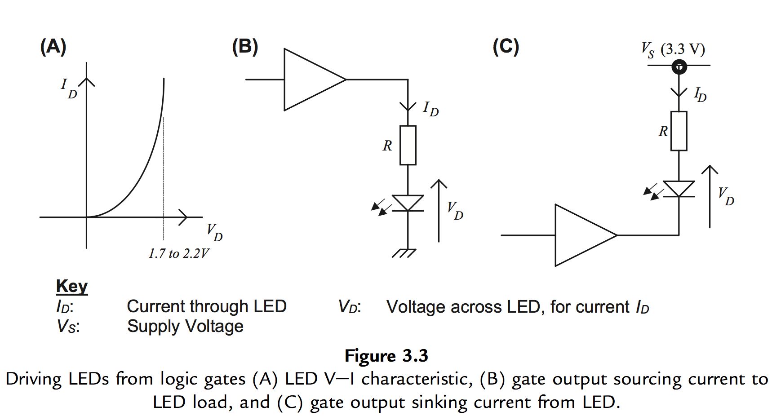
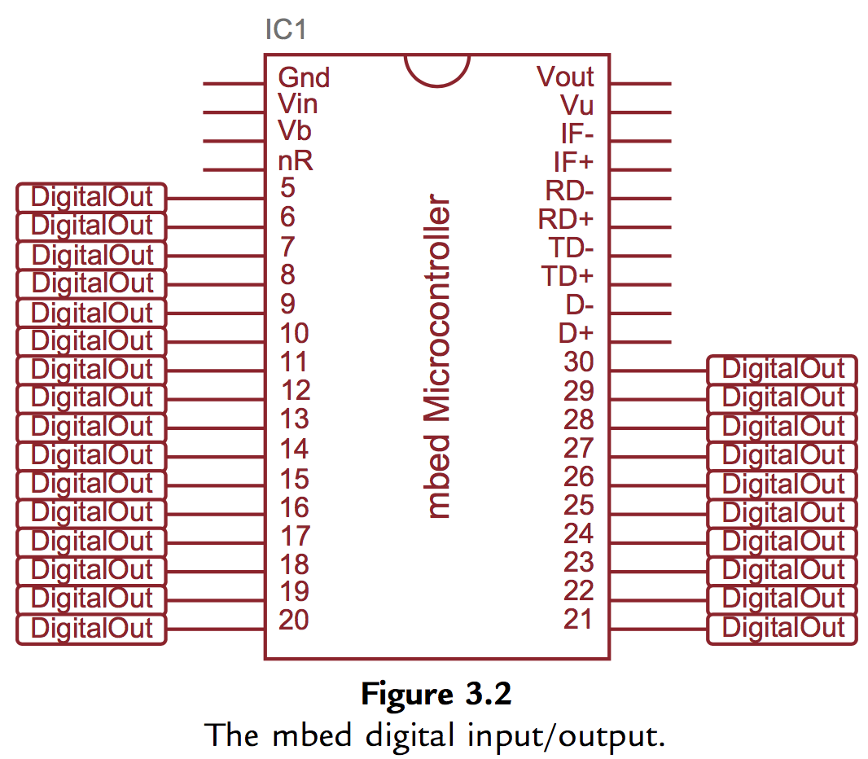
Digital output on the mbed
Using LED

Slide 4
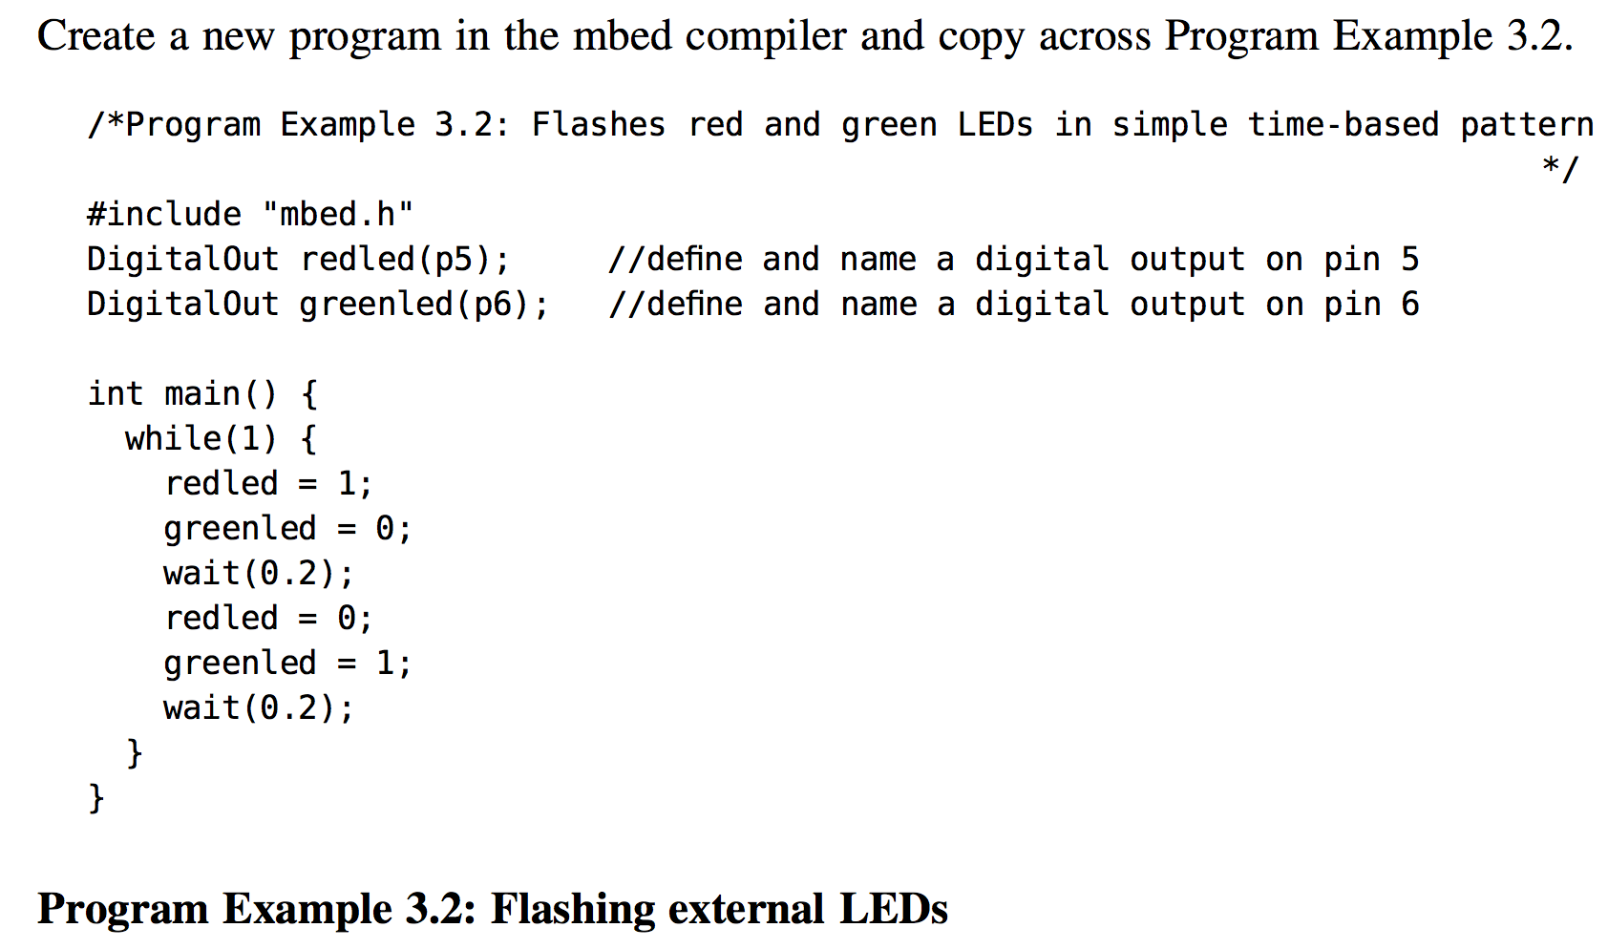
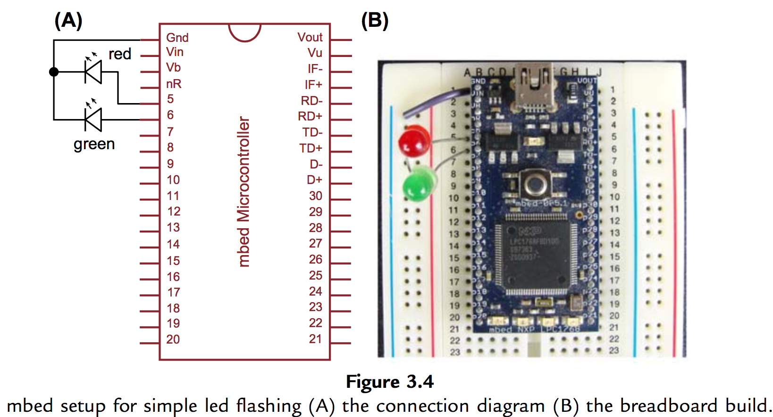
Digital output on the mbed
Using mbed external pins : DigitalOut object

Slide 5
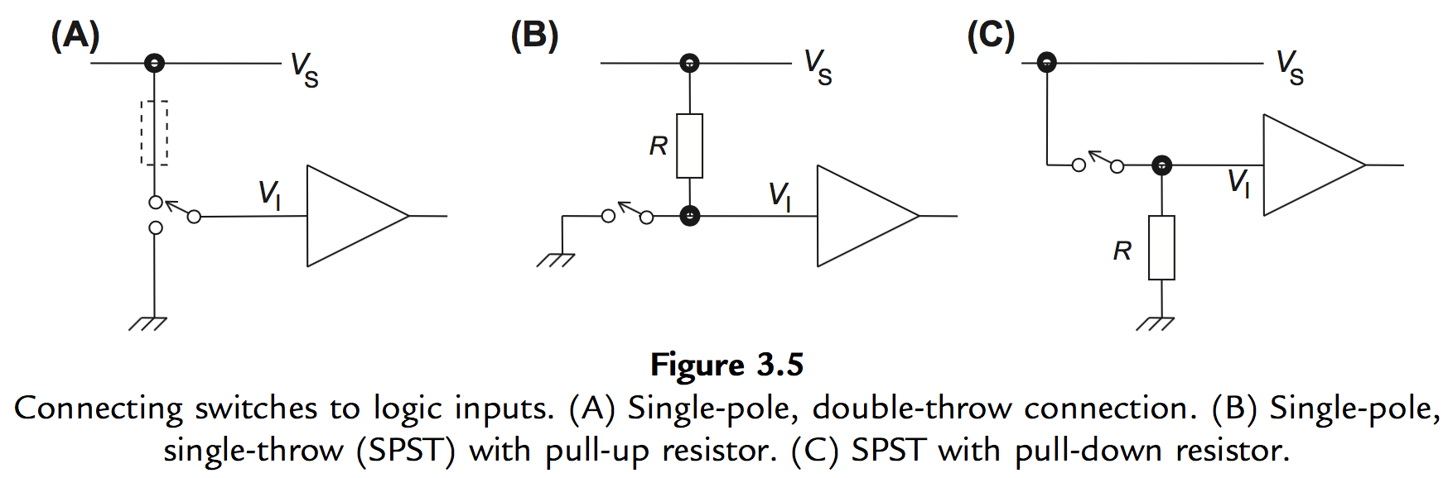
Using Digital inputs
Connecting switches to a digital system

Slide 6
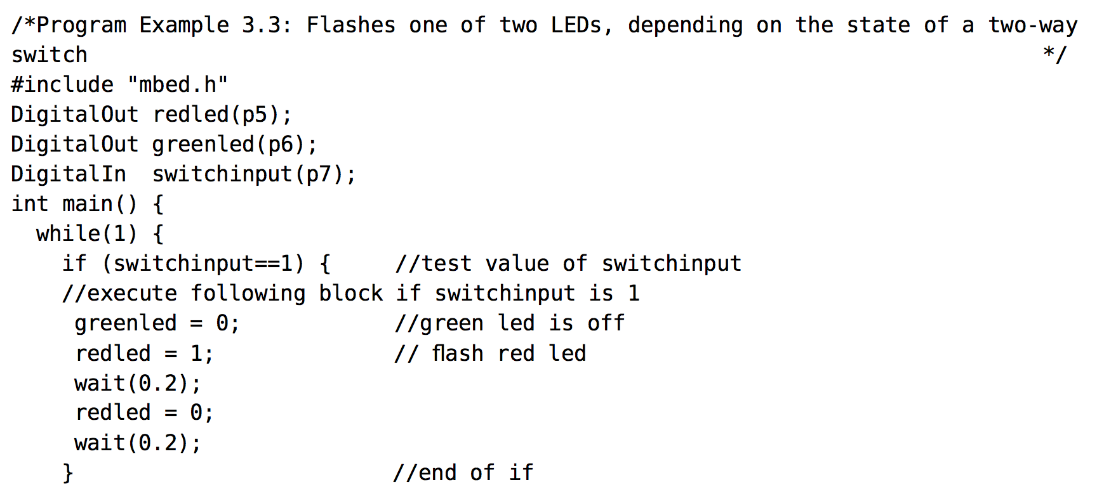
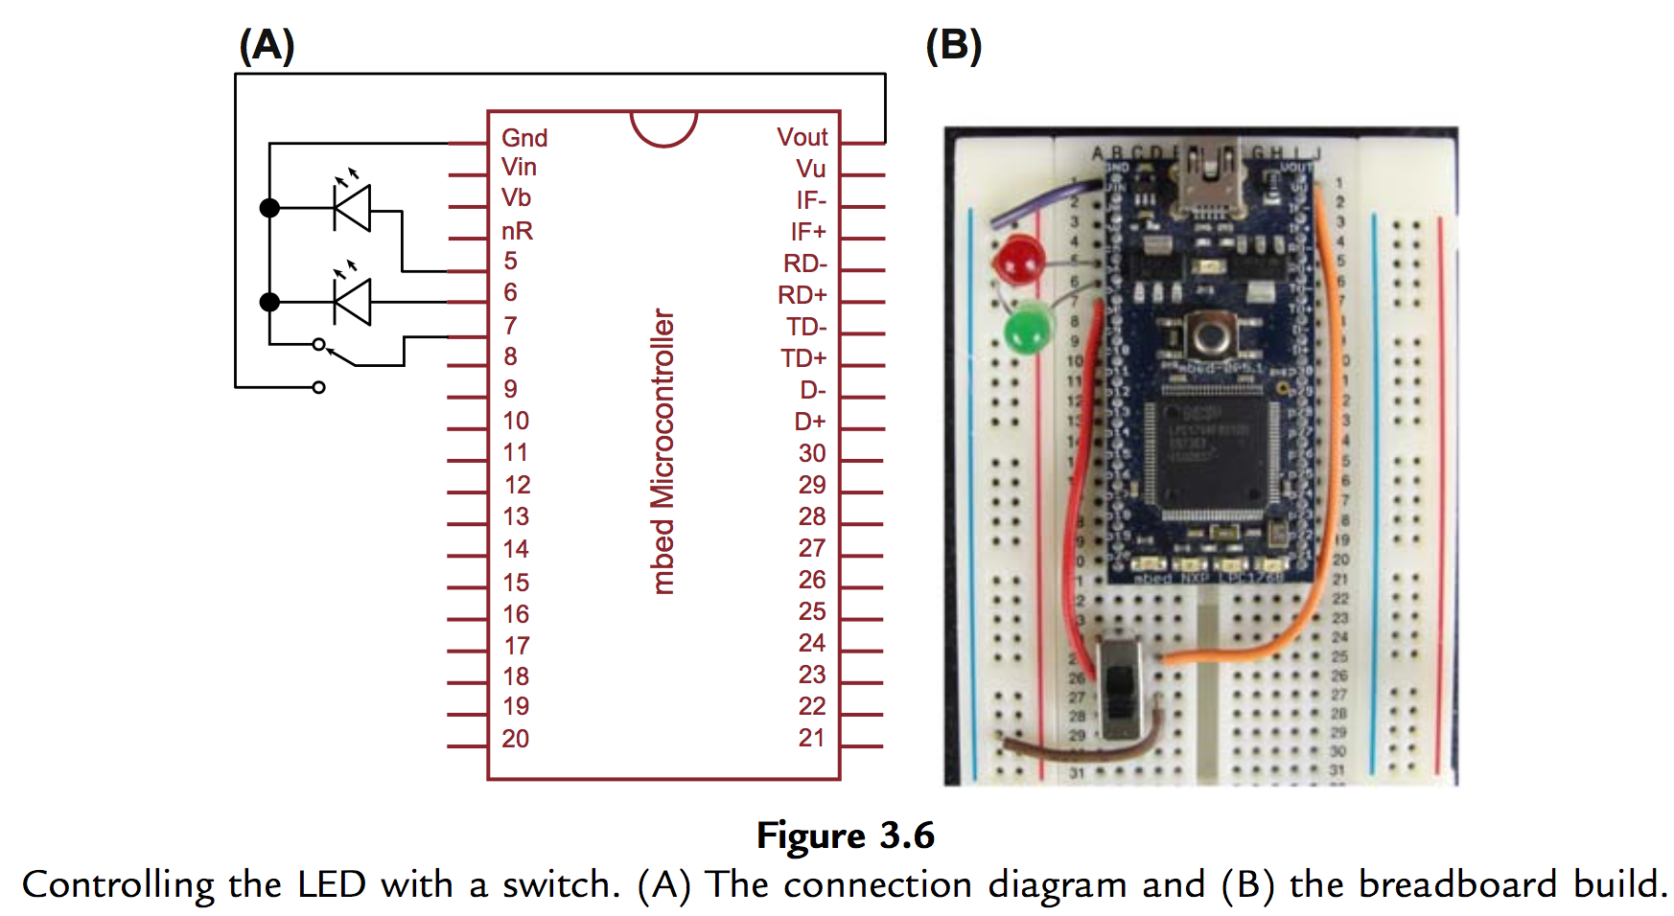
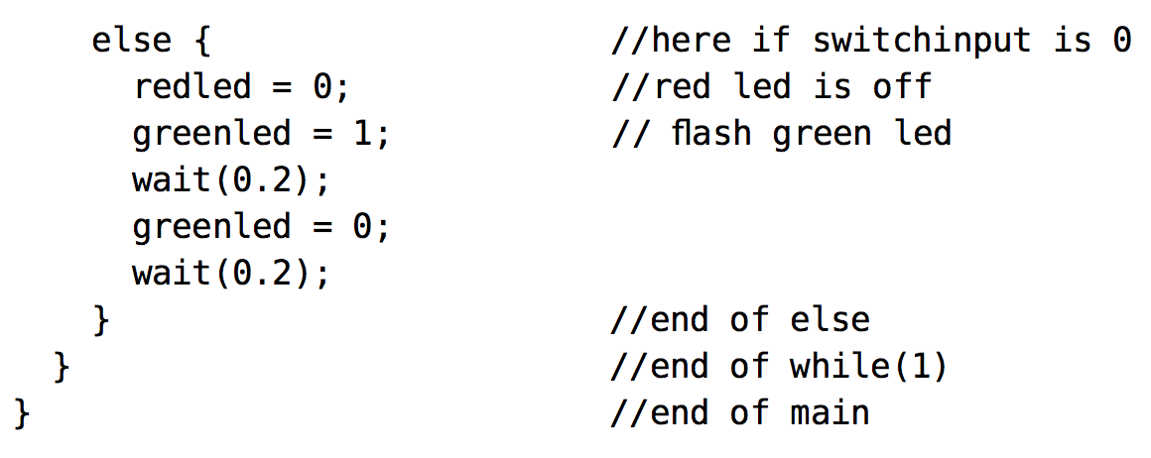
Using digital inputs
DigitalIn api

Slide 7
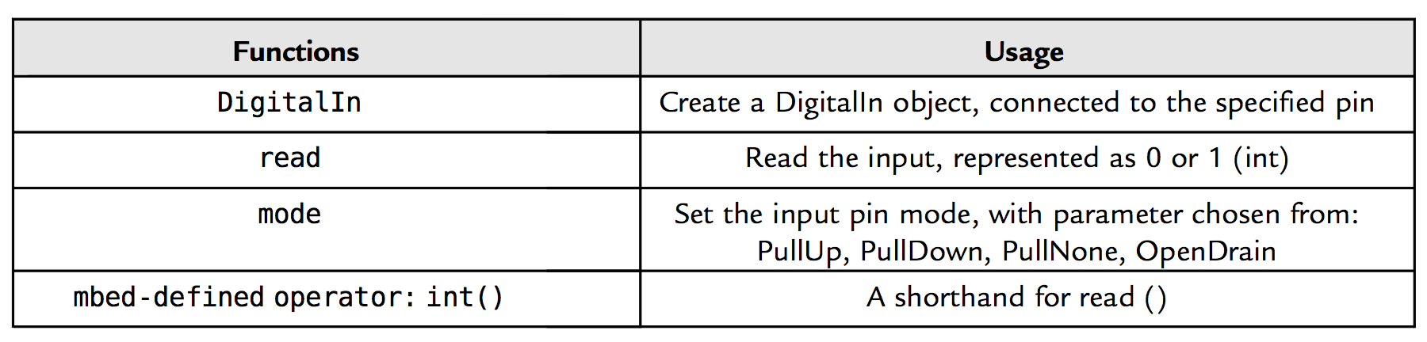
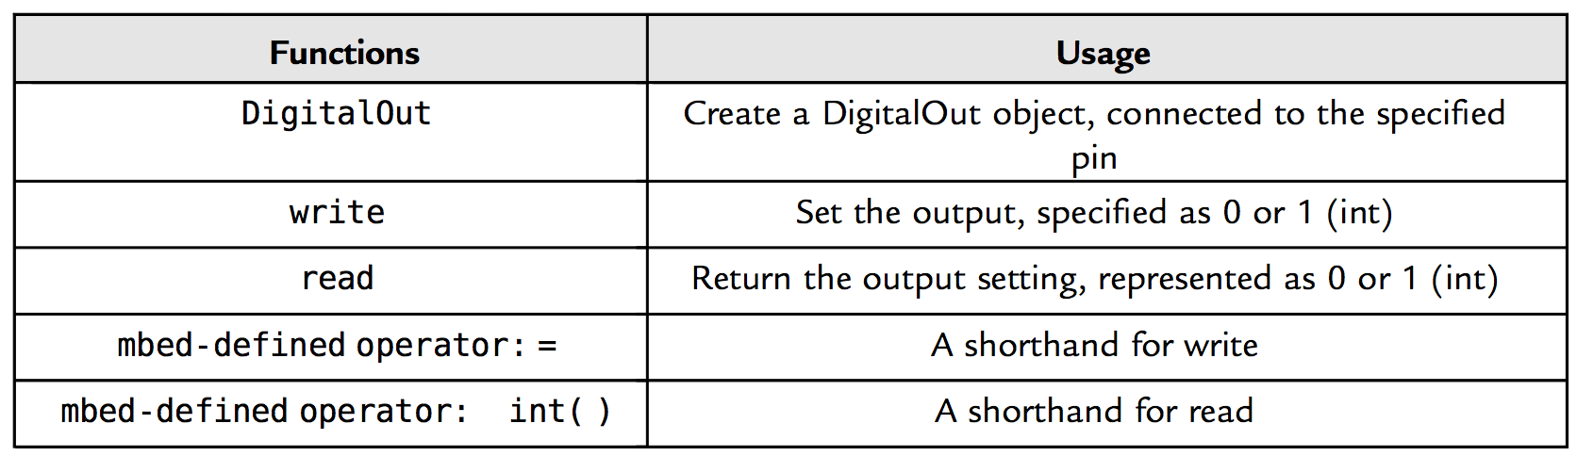
Digital input output api

Slide 8
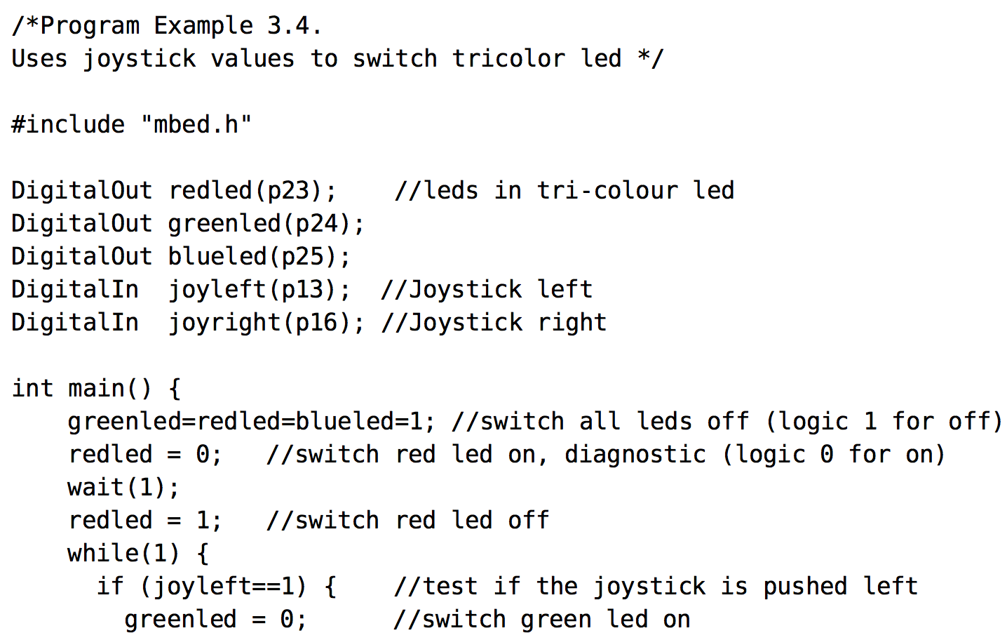
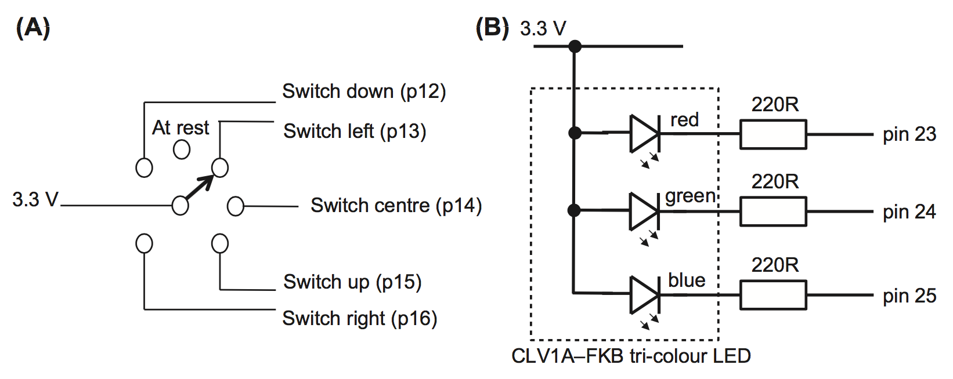
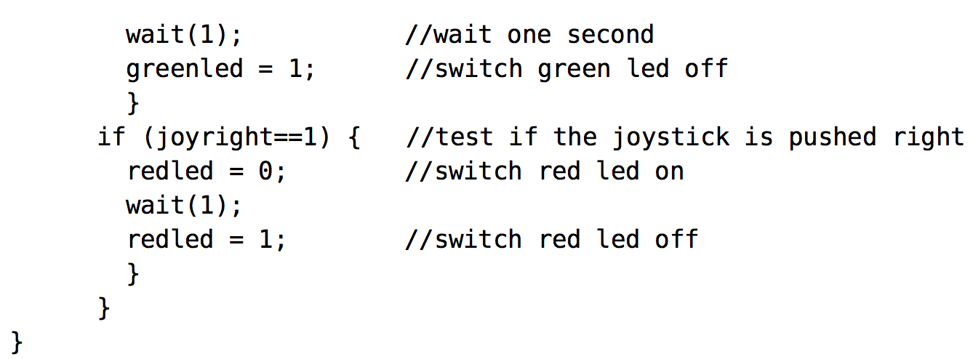
Digital input output devices
Joystick, three-color led

Slide 9
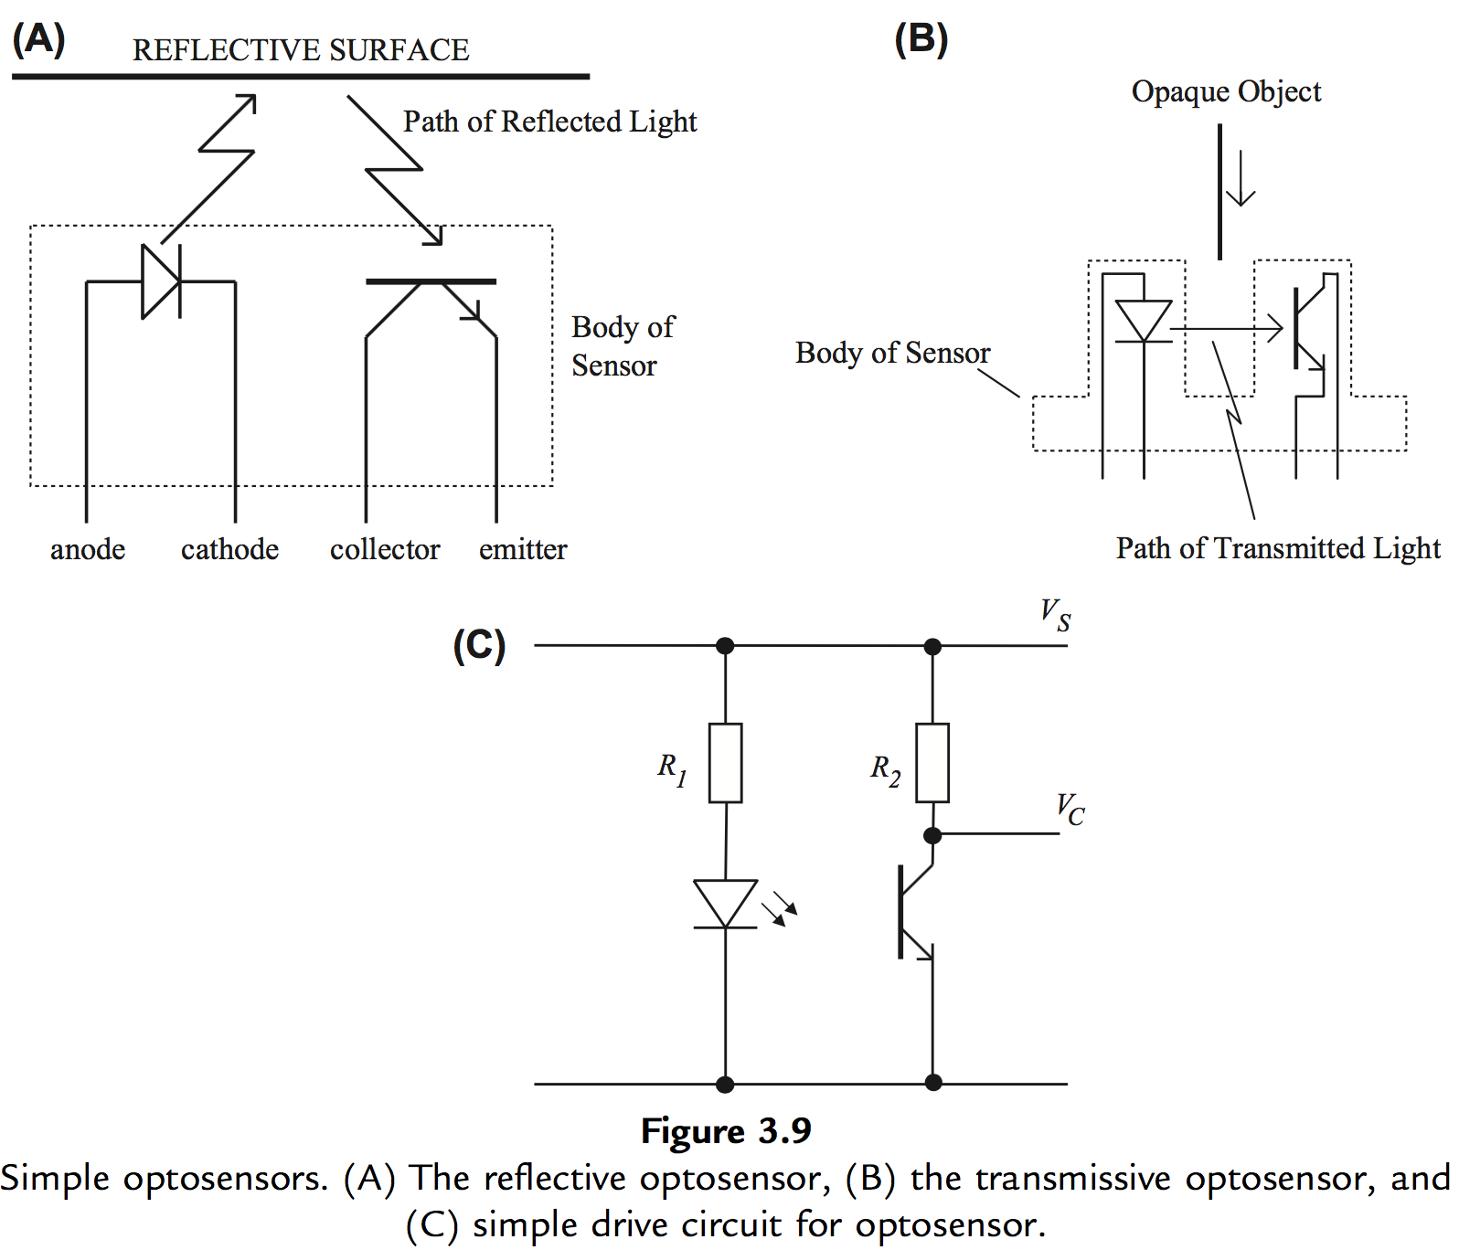
Digital input output devices
Optoreflective and transmissive sensors

Slide 10
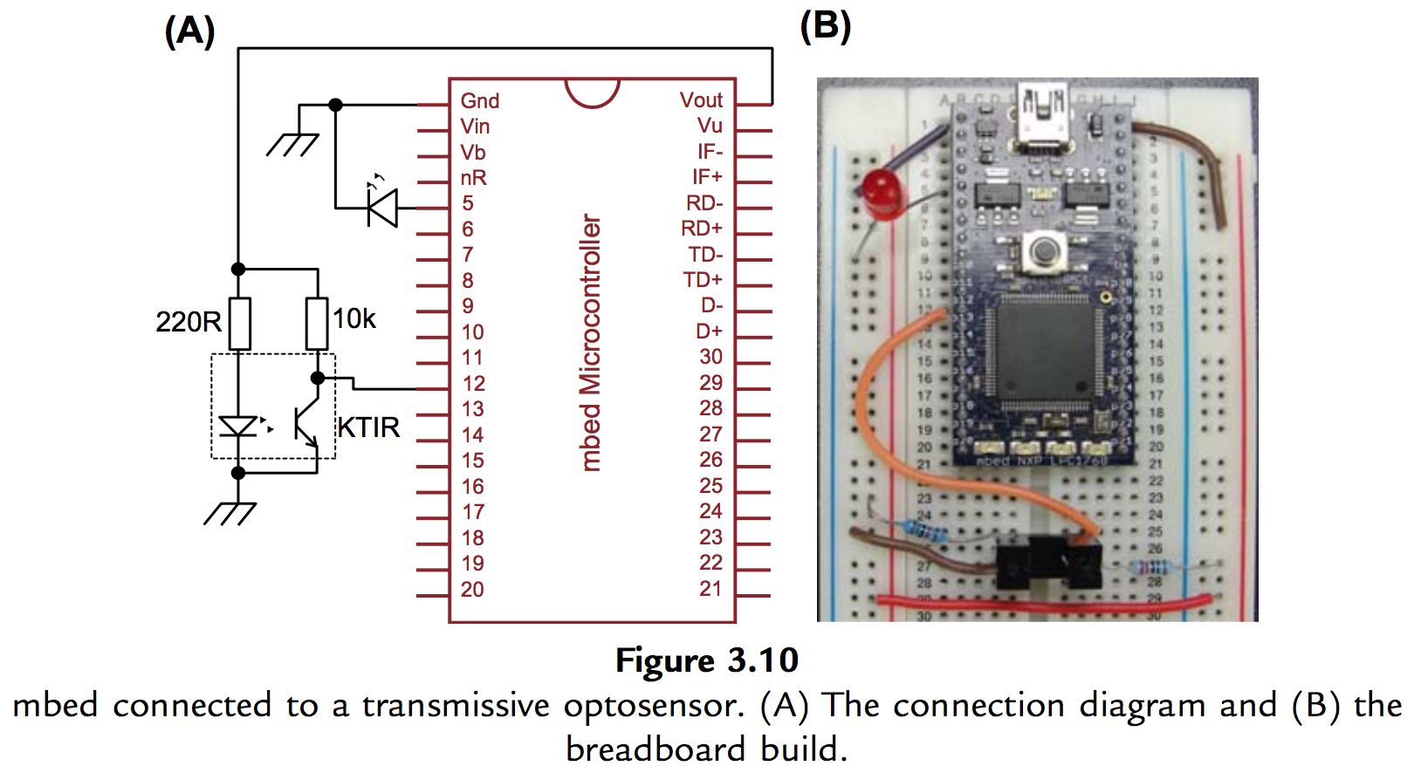
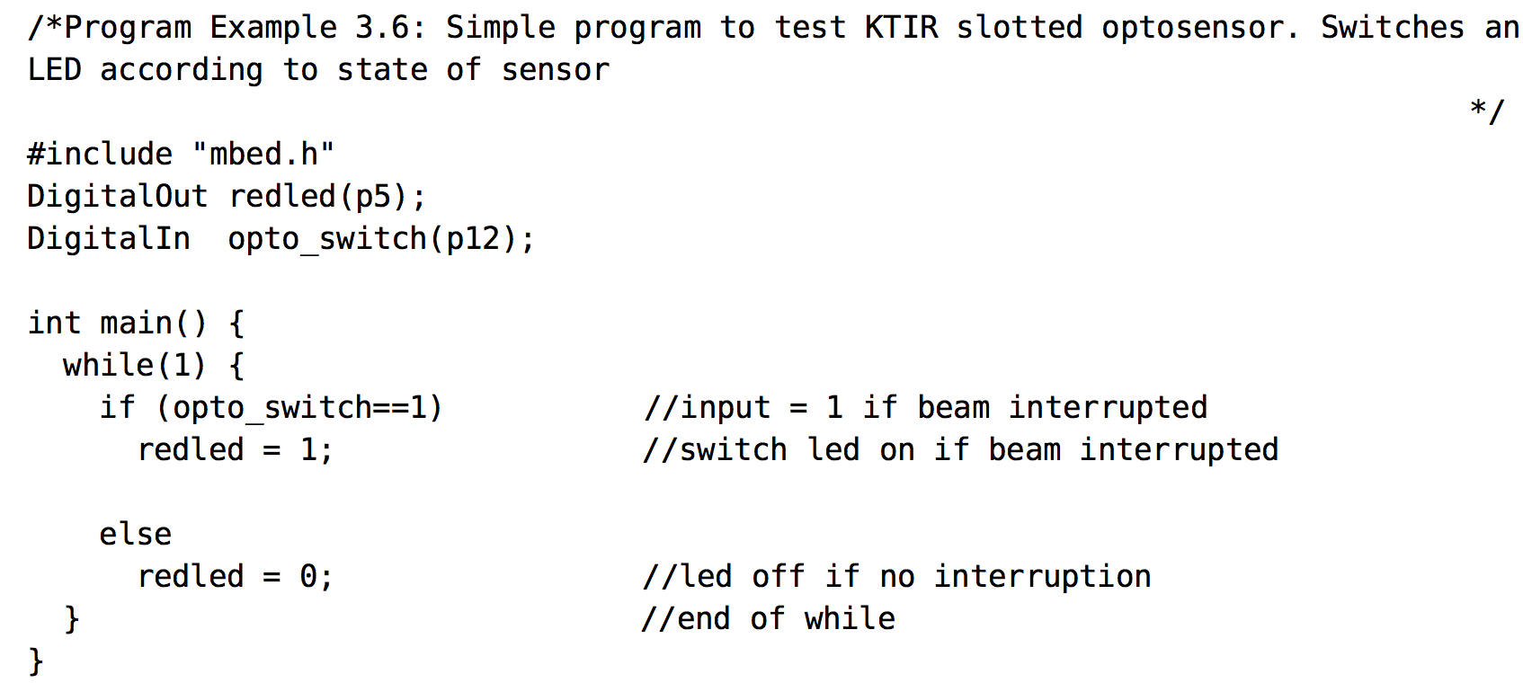
Digital input output devices
Optoreflective and transmissive sensors

Slide 11
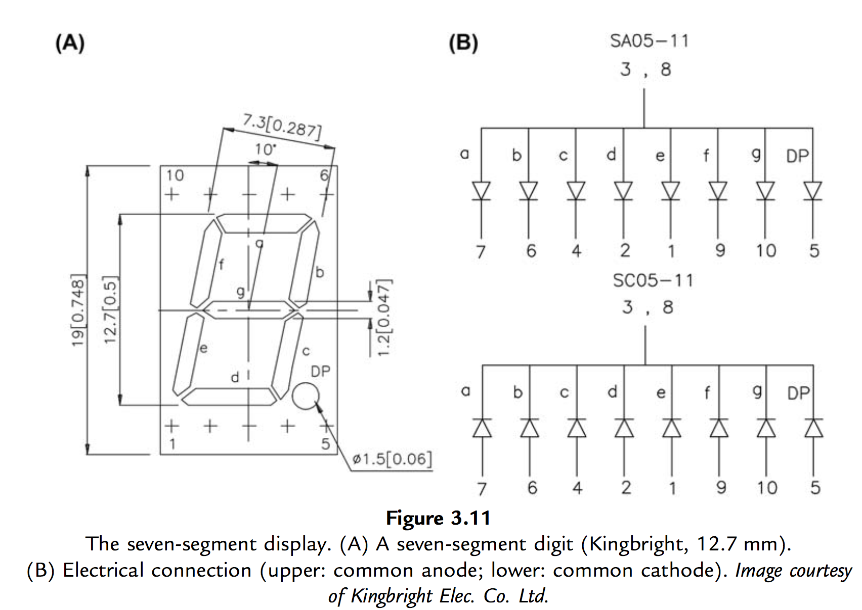
Digital input output devices
Seven-segment display

Slide 12
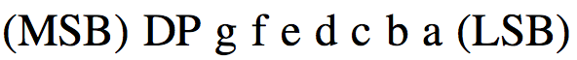
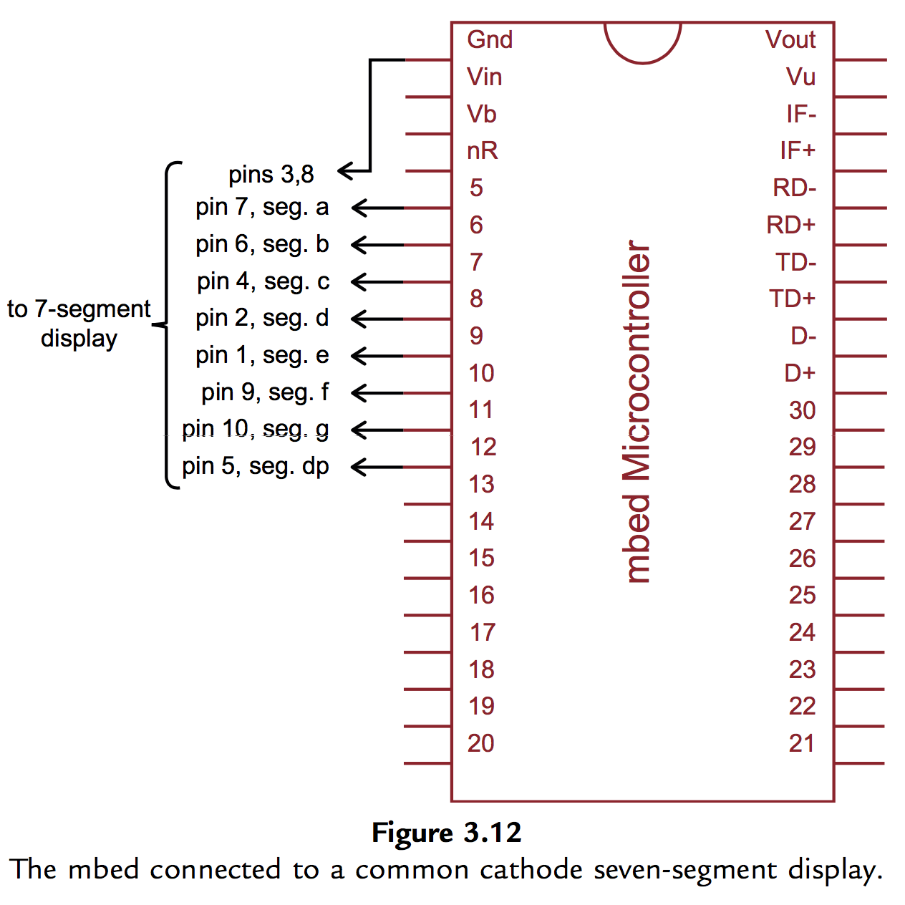
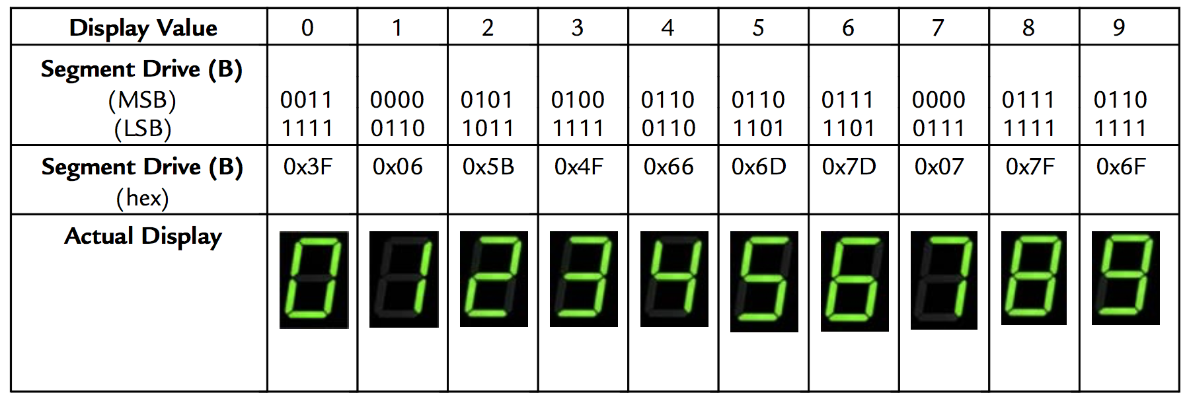
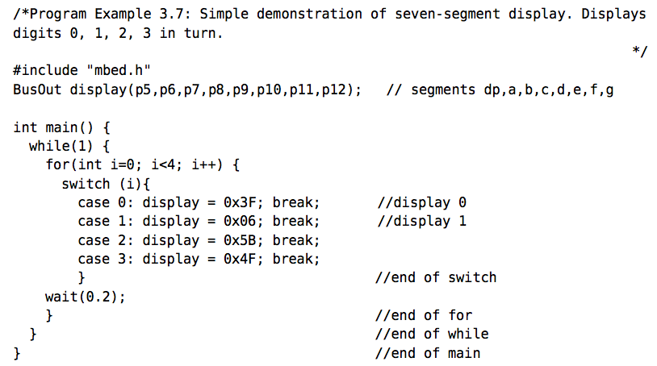
Digital input output devices
Seven-segment display

Slide 13
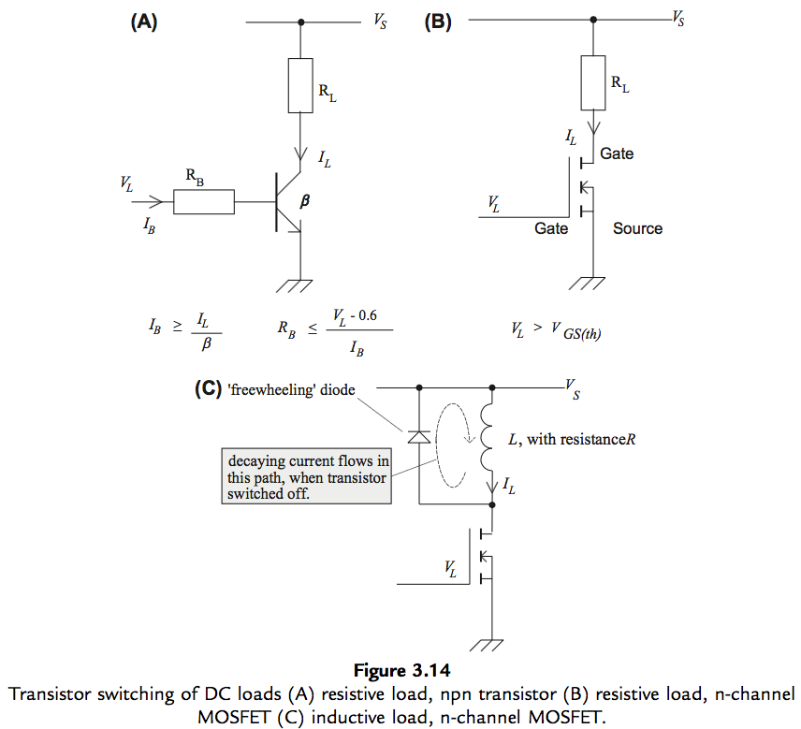
Digital input output devices
Switching larger dc loads :
transistor switching

Slide 14
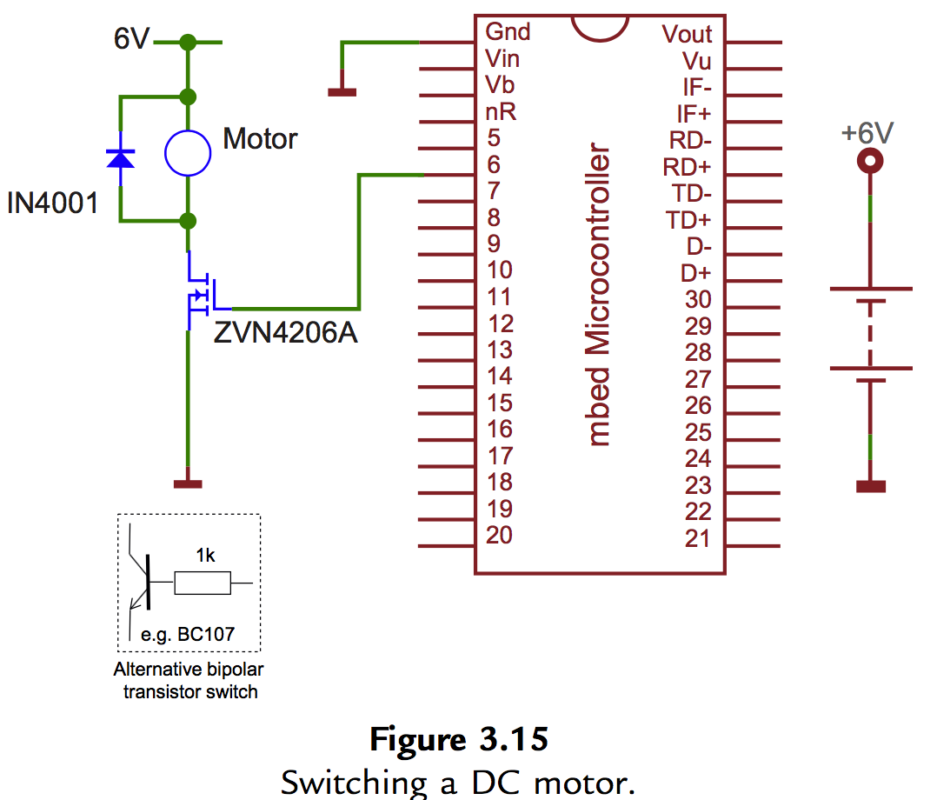
Digital input output devices
Switching larger dc loads :
Switching a dc motor

Slide 15
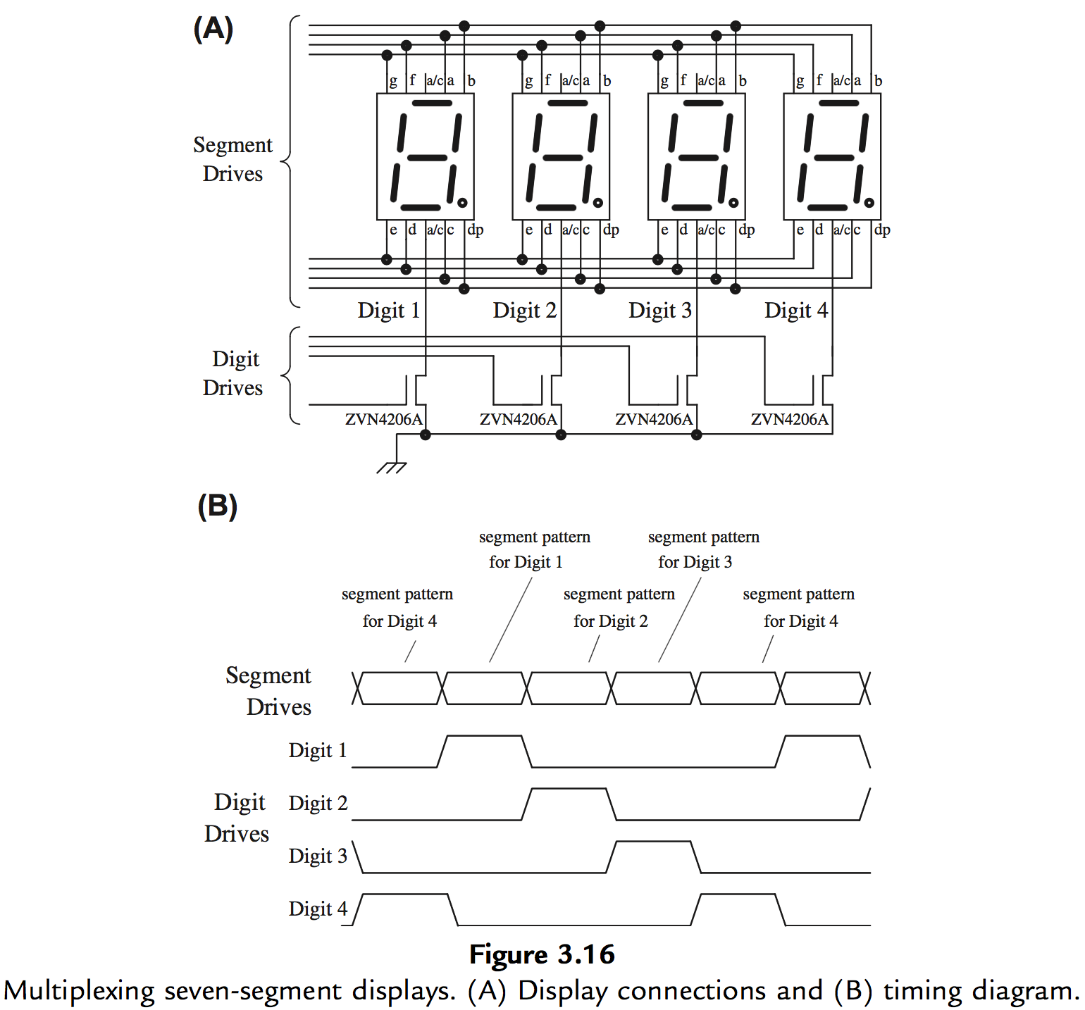
Digital input output devices
Multiple seven-segment displays

Slide 16
Mini project?

